Slide 1

mongo

Slide 2
intro optional

Slide 3
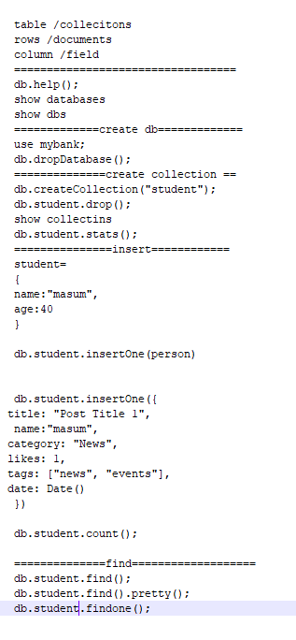
mongo

Slide 4
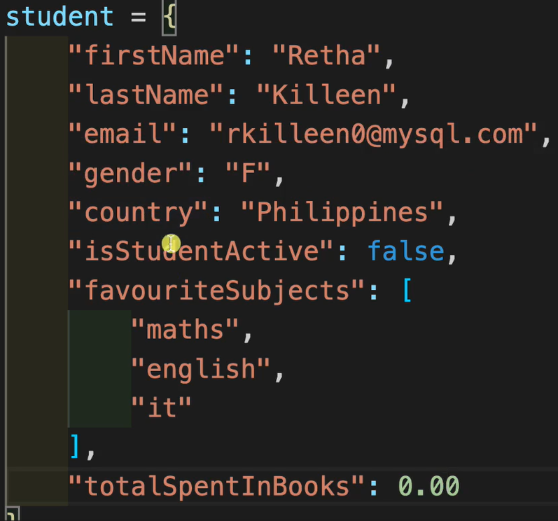
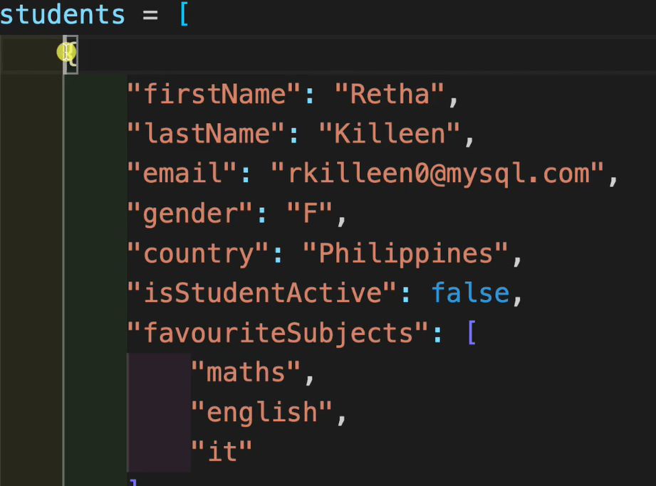
insert many

Slide 5
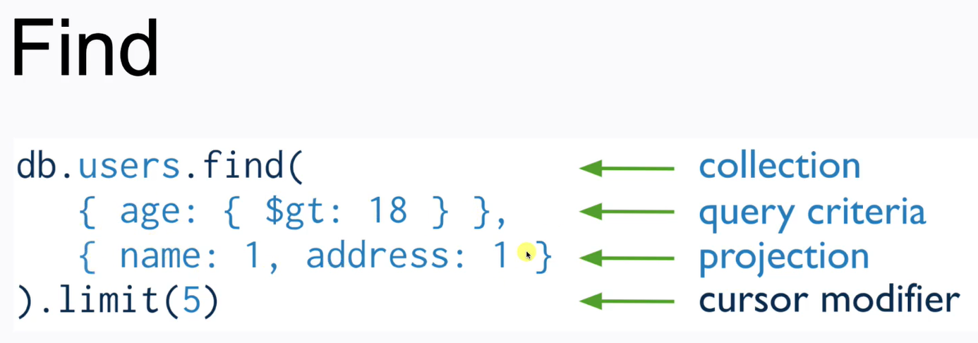

find

Slide 6
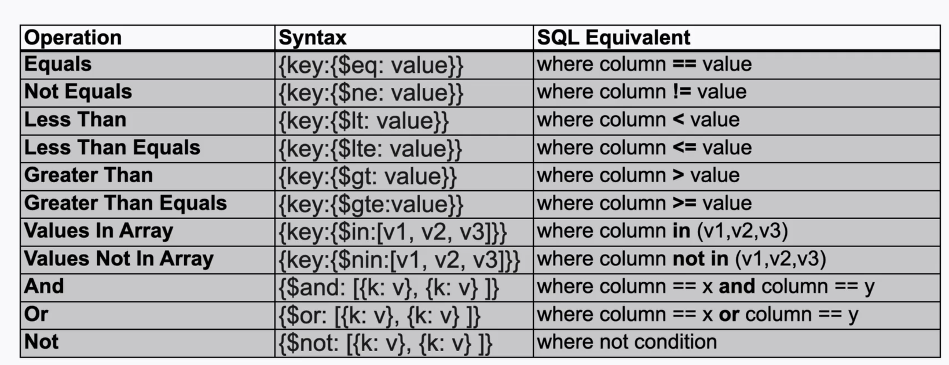
Query Operators

Slide 7
Query Arrays

Slide 8

cursor.forEach

Slide 9
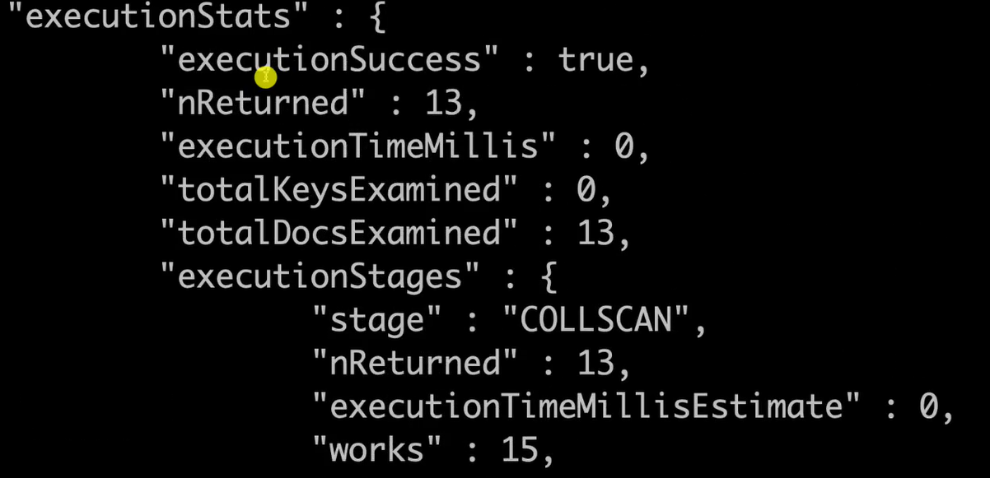
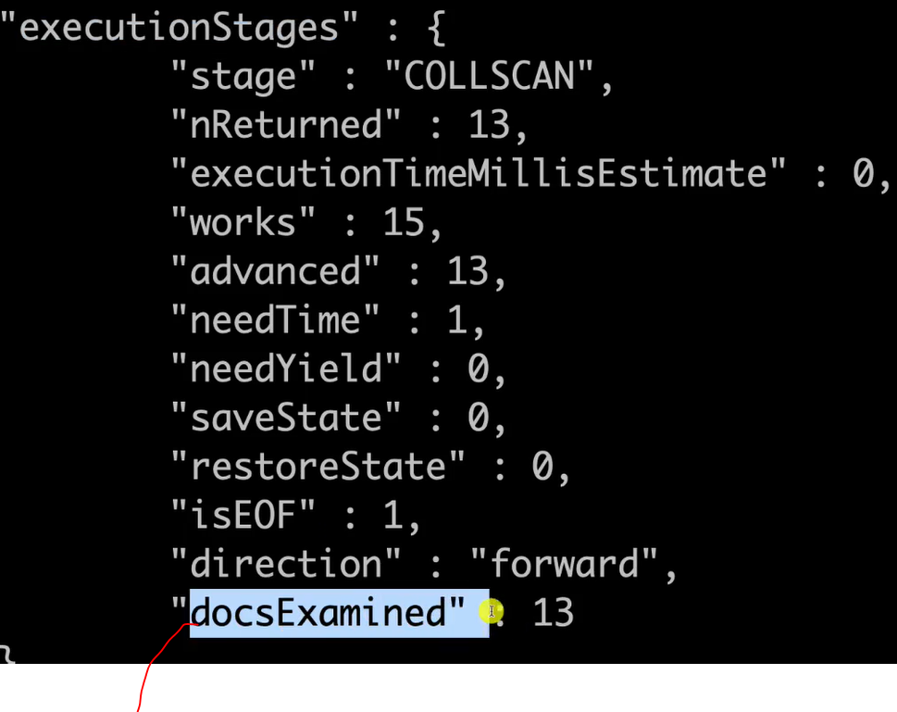
Analysing queries

Slide 10

Creating Indexes

Slide 11
Analysing queries

Slide 12
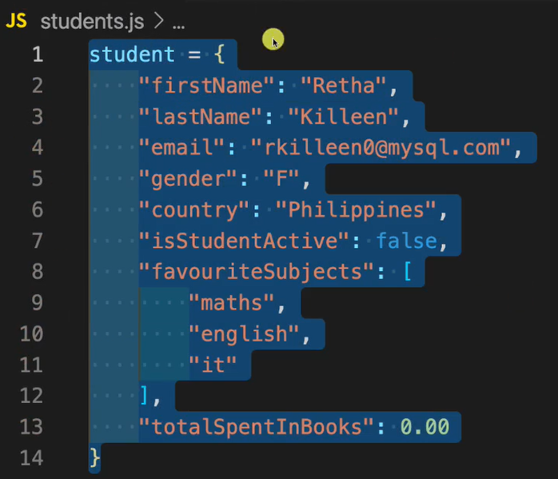
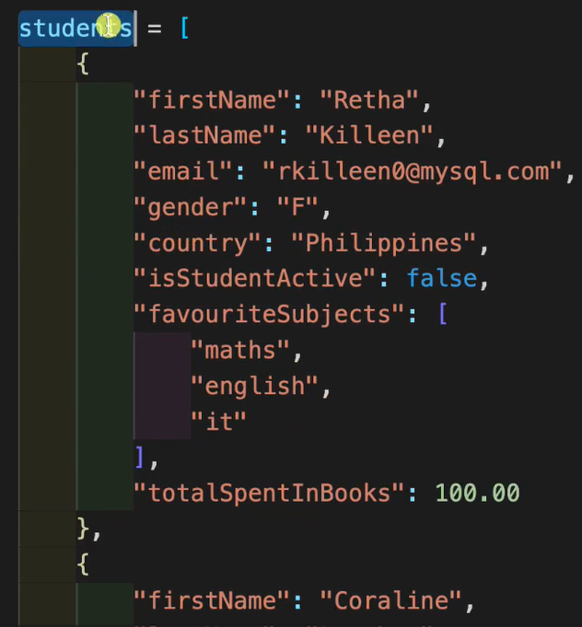
sample data

